Slide 1

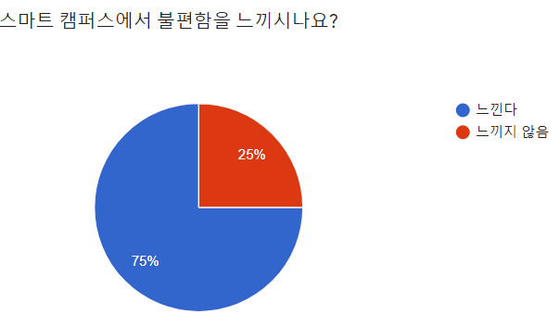
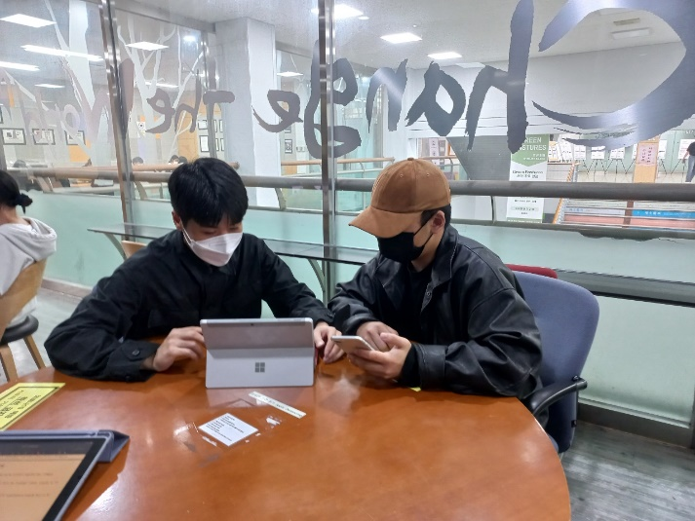
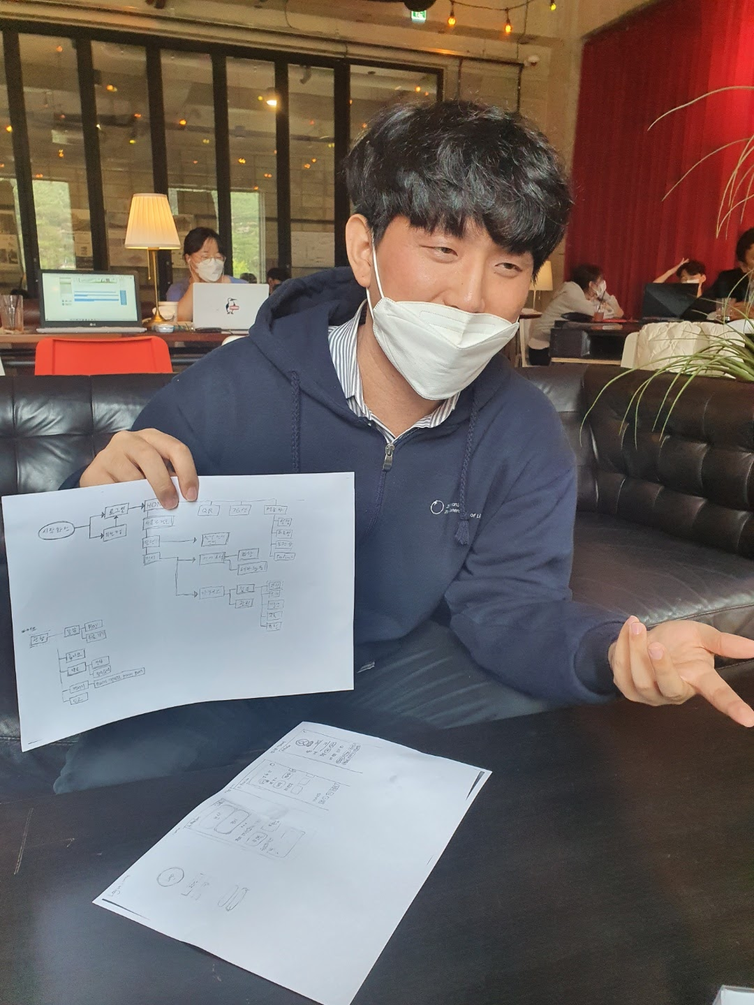
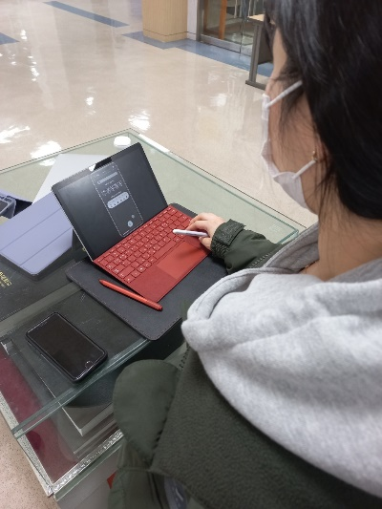
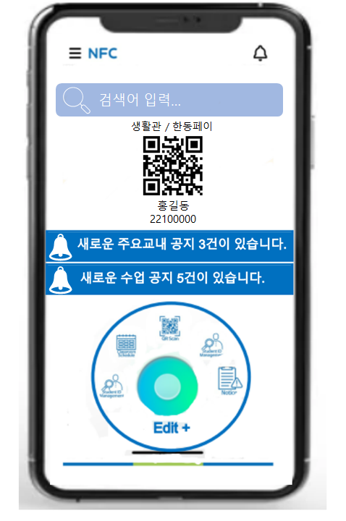
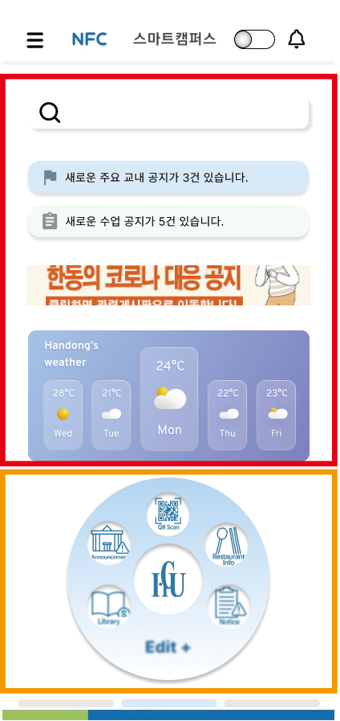
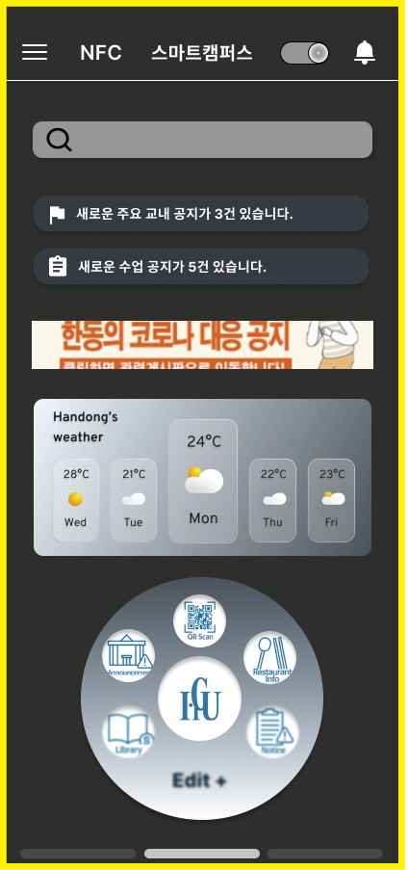
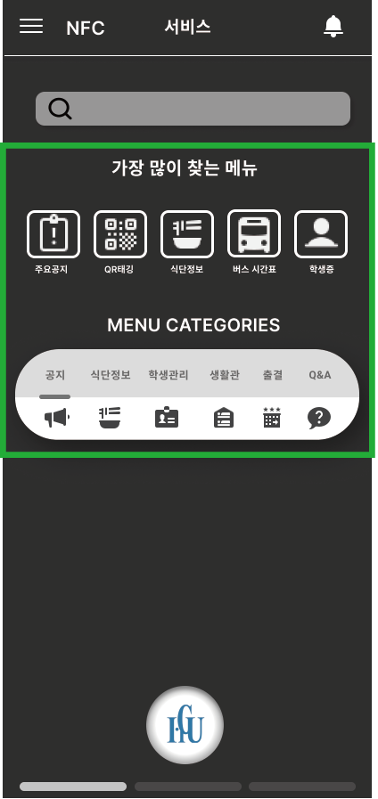


Developing Smart Campus Application
Four Five 뽀빠이 / Team 05
21300543 Seungyoo Lee,21700475 Huichan Yu, 21800720 Hyojung Chun, 218795 Juwon Hong
Background
Purpose of Prototype
I. Problem Cognition
Slow loading speed
Login errors and server collisions
QR tagging not being on the main screen
complicated menu
configuration access multiple functions
Correction that causes cognitive errors (human error) : it was difficult to solve the problem caused by abnormalities in functions at the prototype stage.
Adding a new function that considers the user's physical characteristics.
<User Survey>
Plan for Prototype
II. 1st Feasibility Test
(Interviewing 18 people)
Reorganizing the Start Screen
A) Add: Search bar for announcement, Notification for new announcement, Weather Widget
B) Change: Decreasing size of school notice banner
2. Setting personal quick menu “My Favorite Menu”
: Users can save their own favorite menus in the quick menu slot
3. Adding a Dark Mode
4. Reorganizing the Menu Screen
: Most used menus, Category classification
Q. What's the most inconvenient thing about smart campus applications?
1. Uncomfortable due to lack of function
2. Inconvenient in functioning
3. Uncomfortable due to functional congestion
Bus time 302, information on convenience facilities in school, HISNET mobile version, dark mode.
One-click complaints, application for a stay out of the dormitory, biometric authentication time of Handong Pay, inconvenience of moving the screen slide, error when accessing the notice, confirmation and time of dormitory ID, and some menus are not even executed properly.
The interface is messy, too many menus, icons and menu names are not intuitive.
Changes of Prototype
Experiments
<Figma>
Purpose
To find a problem with an existing Smart Campus app and check whether the problem has been solved when Smart Campus is replaced with the new version
Feasibility Test using Prototype
Supplies
Participants
Equipment
Methods
(18 people)
1. Improvements compared to the previous app
2. Any inconvenience(improvement) in the current prototype
Intuitive reinforcement by changing UI design
Removal: School Notice Banner, Weather Widget, ID verification
Change: bell button and notice alarm button at the top right (there is no difference at present), quick menu, menu icon/font size (currently too small to recognize), dark mode button (currently difficult to intuitively recognize)
Add: Go to the Hisnet button, menus in the category
Emotional Design
Reducing time by organizing quick menu
Physical consideration of users through dark mode
Plan for Future
Handong Students who use Smart Campus Application
Two students from each grace Freshman, Sophomore, and Junior and Senior
Eye tracker
Cell phone
Camera
Survey Paper
Introduction of the experiment
Compare the prototype to the existing smart campus
Get feedbacks from the users using an eye tracker.
1. Adding alarm function : Time for attendance tagging before class, closing assignment, alarm tailored to wake-up.
2. Adding the HISNET Link and mobile version
3. Adding a new menu : Information about classroom location, facility reservation, bus location check, school department phone number through map.
4. Existing menu improvement : Handong Pay (Easier to use), food information (week/monthly), school notice (can be searched by number), ID verification (certification x)
5. Changing the main screen : Listing all the notice, placing the most used menus on the main screen, removing the weather widget.
Quantitative
How much users touched and how quickly users found it (count the second)
Qualitative
How convenient did users felt comparing to the previous version (using eye tracker and interview)
Notes:
Partial correction that causes cognitive errors.

